Slide 1
Subject : Data Structures & Algorithms
Lecture : 14

Slide 2
Sorting Algorithms

Slide 3
Mergesort
Merge sort algorithm is one of two important divide-and-conquer sorting algorithms (the other one is quicksort).
It is a recursive algorithm.
  Divides the list into halves,
  Sort each halve separately, and
  Then merge the sorted halves into one sorted array.

Slide 4
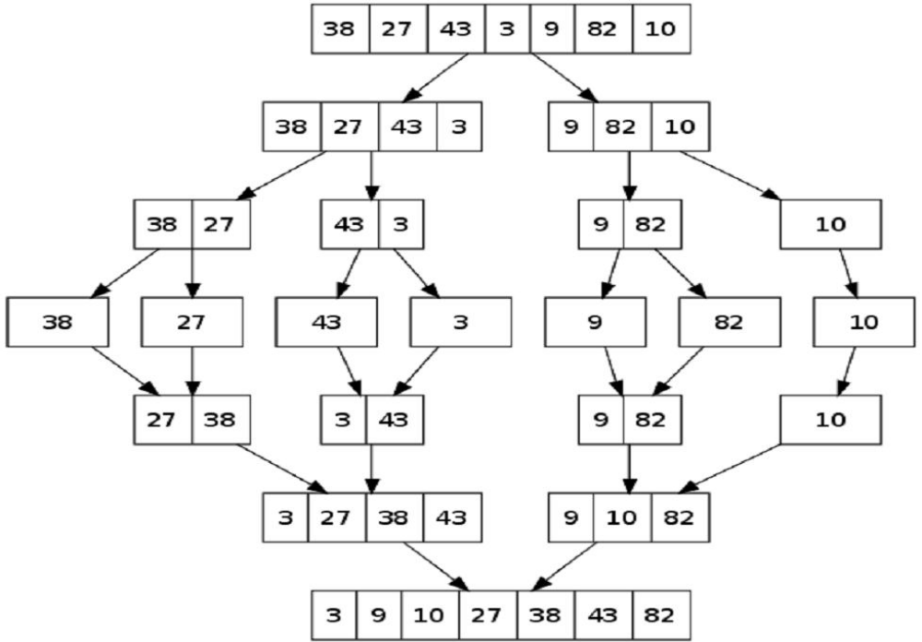


Mergesort - Example

Slide 5


Mergesort - Example
6 | 3 | 9 | 1 | 5 | 4 | 7 | 2
divide
6 | 3 | 9 | 1
5 | 4 | 7 | 2
divide
divide
6 | 3
9 | 1
5 | 4
7 | 2
divide
divide
divide
divide
6
3
9
1
5
4
7
2
merge
merge
merge
merge
3 | 6
1 | 9
4 | 5
2 | 7
merge
merge
1 | 3 | 6 | 9
2 | 4 | 5 | 7
merge
1 | 2 | 3 | 4 | 5 | 7 | 8 | 9

Slide 6
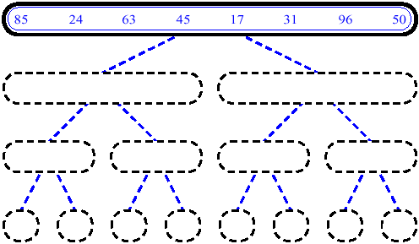
MergeSort (Example) - 1

Slide 7
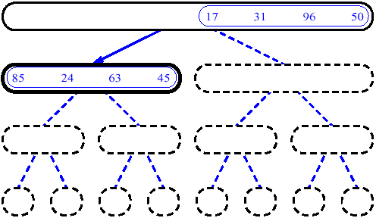
MergeSort (Example) - 2

Slide 8
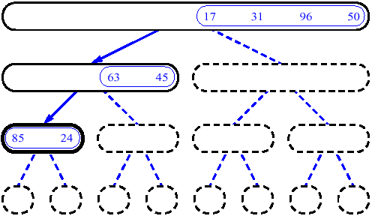
MergeSort (Example) - 3

Slide 9
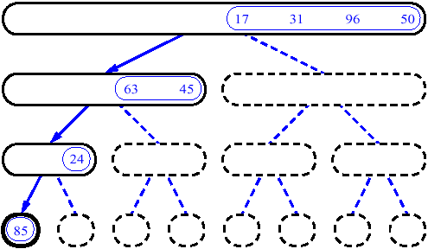
MergeSort (Example) - 4

Slide 10
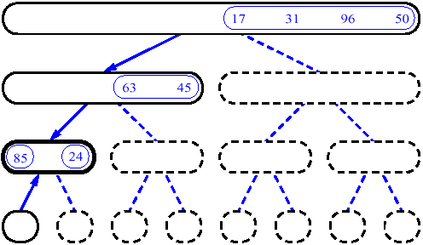
MergeSort (Example) - 5

Slide 11
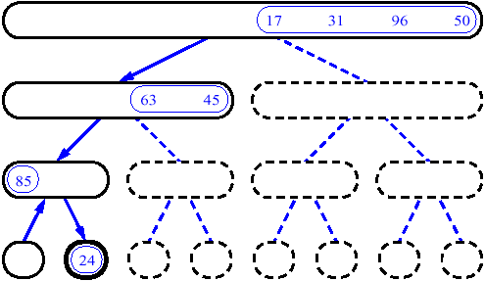
MergeSort (Example) - 6

Slide 12
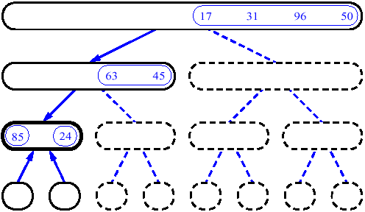
MergeSort (Example) - 7

Slide 13
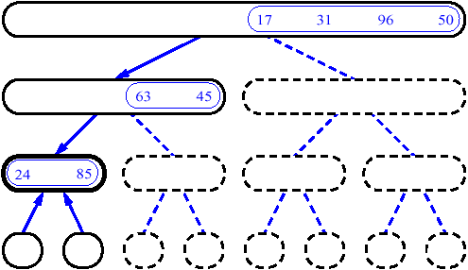
MergeSort (Example) - 8

Slide 14
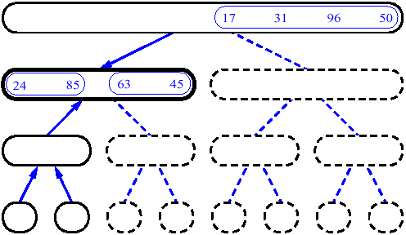
MergeSort (Example) - 9

Slide 15
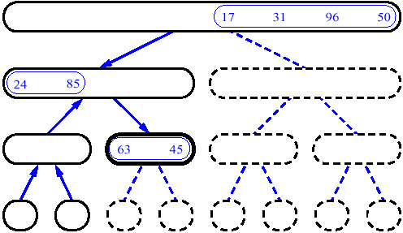
MergeSort (Example) - 10

Slide 16
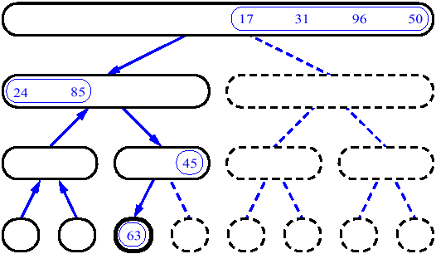
MergeSort (Example) - 11

Slide 17
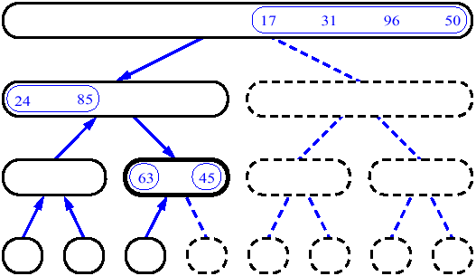
MergeSort (Example) - 12

Slide 18
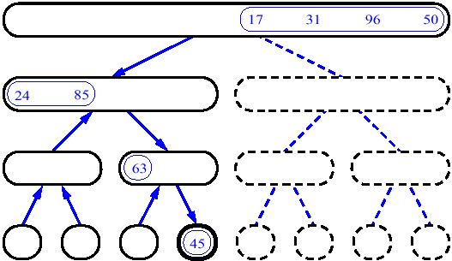
MergeSort (Example) - 13

Slide 19
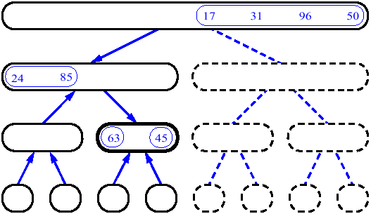
MergeSort (Example) - 14

Slide 20
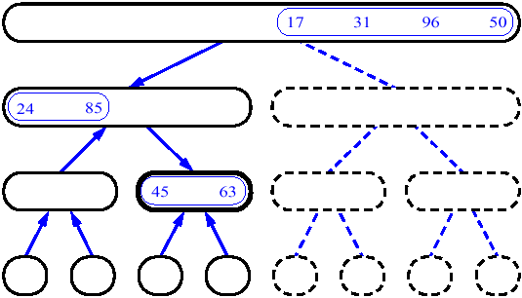
MergeSort (Example) - 15

Slide 21
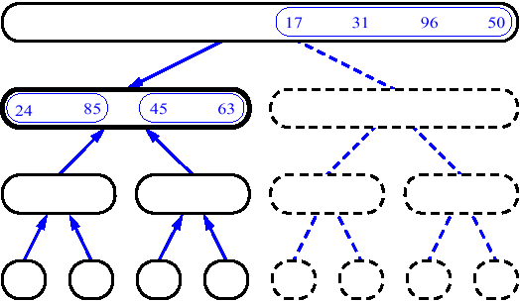
MergeSort (Example) - 16

Slide 22
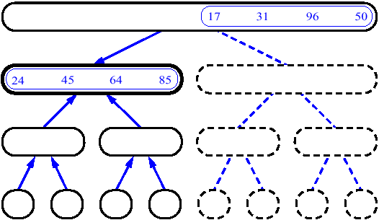
MergeSort (Example) - 17

Slide 23
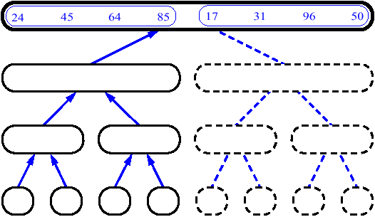
MergeSort (Example) - 18

Slide 24
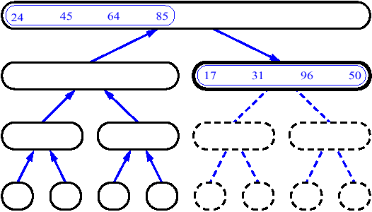
MergeSort (Example) - 19

Slide 25
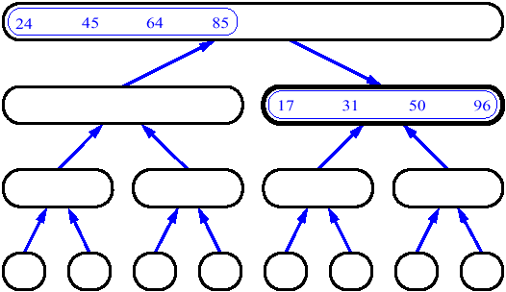
MergeSort (Example) - 20

Slide 26
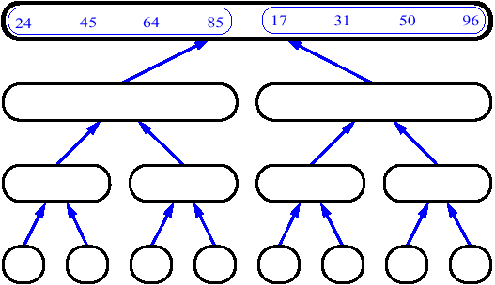
MergeSort (Example) - 21

Slide 27
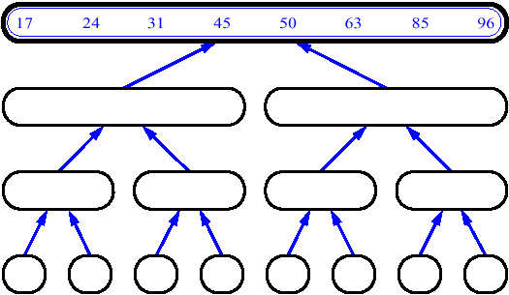
MergeSort (Example) - 22

Slide 28
Merge
14
23
45
98
6
33
42
67

Slide 29
Merge
14
23
45
98
6
33
42
67
Merge

Slide 30
Merge
14
23
45
98
6
33
42
67
6
Merge

Slide 31
Merge
14
23
45
98
6
33
42
67
6
14
Merge

Slide 32
Merge
14
23
45
98
6
33
42
67
6
14
23
Merge

Slide 33
Merge
14
23
45
98
6
33
42
67
6
14
23
33
Merge

Slide 34
Merge
14
23
45
98
6
33
42
67
6
14
23
33
42
Merge

Slide 35
Merge
14
23
45
98
6
33
42
67
6
14
23
33
42
45
Merge

Slide 36
Merge
14
23
45
98
6
33
42
67
6
14
23
33
42
45
67
Merge

Slide 37
Merge
14
23
45
98
6
33
42
67
6
14
23
33
42
45
67
98
Merge

Slide 38

Merge Sort Algorithm
proc mergeSort(arr[1…n], p, r)
if p < r then
  q ← (p+r)/2
  mergeSort(arr, p, q)
  mergeSort(arr, q+1, r)
  merge(arr, p, q, r)
  end if
end proc
Every pass of mergeSort() procedure consists of two recursive function calls to itself followed by one call to merge
mergeSort(arr, p, r) function checks whether p (index) is less than r (index)
If it is so, it makes two calls to itself splitting the array into two halves
Every further call splits array into further two halves with available indexes until p is not less than r (when will this happen?)
Every further call splits array into further two halves with available indexes until p is not less than r (when will this happen?)
At this point a merge(arr, p, q, r) call will be made to merge two halves into a sorted chunk

Slide 39
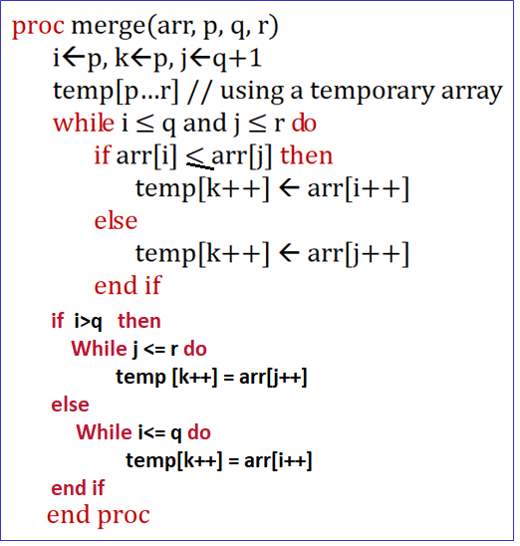
Merge Sort … merge(arr, p, q, r)Call

Slide 40
Quicksort
Like merge sort, Quicksort is also based on the divide-and-conquer paradigm.
Quicksort is a divide and conquer algorithm, which relies on a partition operation: to partition an array, we choose an element, called a pivot, move all smaller elements before the pivot, and move all greater elements after it.
This can be done efficiently in linear time and in-place. We then recursively sort the lesser and greater sub lists. Efficient implementations of quicksort (with in-place partitioning) are somewhat complex, but are among the fastest sorting algorithms in practice.

Slide 41
Quicksort (cont.)
The most complex issue in quicksort is choosing a good pivot element; consistently poor choices of pivots can result in drastically slower.
The quick-sort algorithm consists of the following three steps:
1. Divide: Partition the list.
  To partition the list, we first choose some element from the list for which we hope about half the elements will come before and half after. Call this element the pivot.
  Then we partition the elements so that all those with values less than the pivot come in one sub list and all those with greater values come in another.
2. Recursion: Recursively sort the sub lists separately.
3. Conquer: Put the sorted sub lists together.

Slide 42
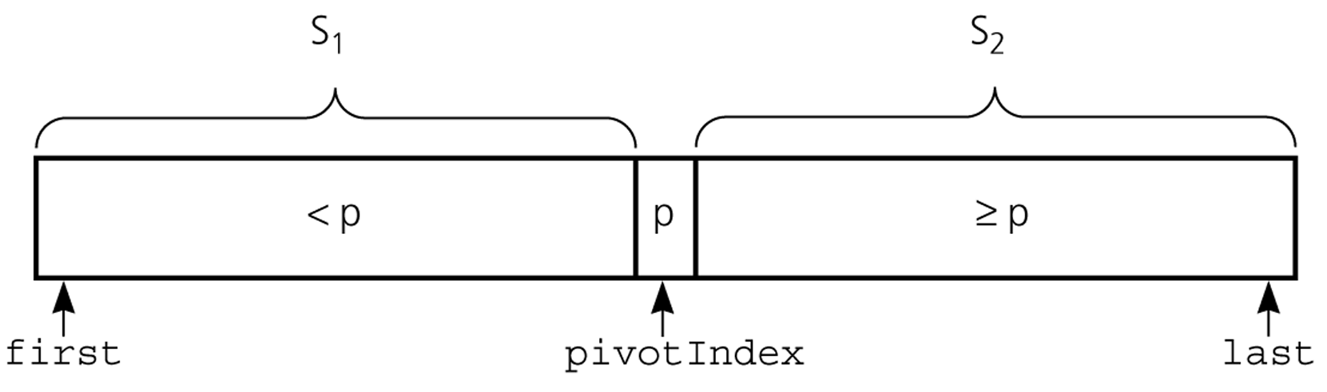
Partition
Partitioning places the pivot in its correct place position within the array.
Arranging the array elements around the pivot p generates two smaller sorting problems.
  sort the left section of the array, and sort the right section of the array.
  when these two smaller sorting problems are solved recursively, our bigger sorting problem is solved.

Slide 43
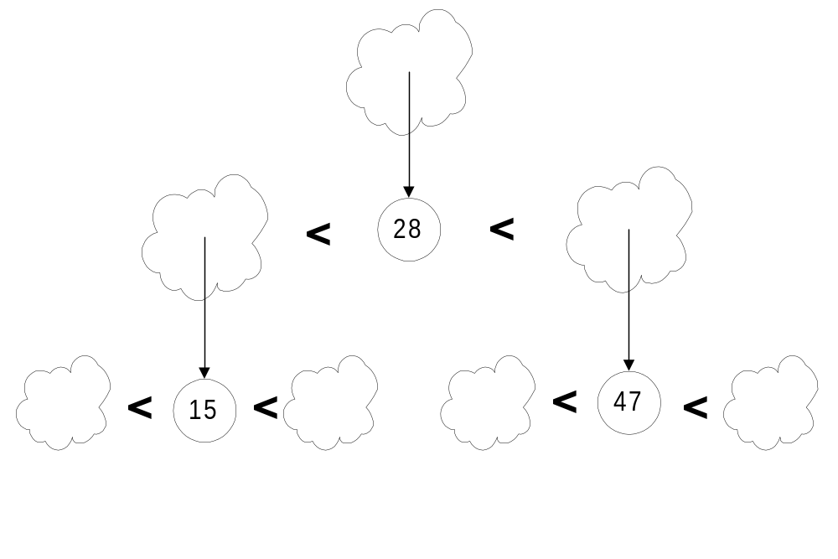
Quick Sort
Pick a “pivot”
Divide into less-than & greater-than pivot
Sort each side recursively

Slide 44
The steps of QuickSort
S
81
31
57
select pivot value
13
43
75
92
0
65
26
S₁
S₂
partition S
0
31
75
13
43
65
92
81
26
57
QuickSort(S₁) and
QuickSort(S₂)
S₁
S₂
0
13
26
31
43
57
65
75
81
92
S
Presto! S is sorted
0
13
26
31
43
57
65
75
81
92
[Weiss]

Slide 45
QuickSort Example
i
j
5
1
3
9
7
0
4
2
6
8
i
j
5
1
3
9
7
0
4
2
6
8
i
j
5
1
3
9
7
0
4
2
6
8
i
j
5
1
3
2
7
0
4
9
6
8
Move i to the right to be larger than pivot.
Move j to the left to be smaller than pivot.
Swap

Slide 46
QuickSort Example
i
j
5
1
3
2
7
0
4
9
6
8
i
j
5
1
3
2
7
0
4
9
6
8
i
j
5
1
3
2
4
0
7
9
6
8
i
j
5
1
3
2
4
0
7
9
6
8
j
i
5
1
3
2
4
0
7
9
6
8
j
i
0
1
4
2
4
5
6
9
7
8
S₁ < pivot
pivot
S₂ > pivot

Slide 47
Partition – Choosing the pivot
First, we have to select a pivot element among the elements of the given array, and we put this pivot into the first location of the array before partitioning.
Which array item should be selected as pivot?
  Somehow we have to select a pivot, and we hope that we will get a good partitioning.
  If the items in the array arranged randomly, we choose a pivot randomly.
  We can choose the first or last element as a pivot (it may not give a good partitioning).
  We can use different techniques to select the pivot.

Slide 48
Quick sort vs. Merge sort
Quick sort:
  pick a pivot value from the array
  partition the list around the pivot value
  sort the left half
  sort the right half
Merge sort:
  divide a list into two identically sized halves
  sort the left half
  sort the right half
  recombine the sorted halves into a sorted whole

Slide 49
Partition Function
template <class DataType>
void partition(DataType theArray[], int first, int last,
int &pivotIndex) {
// Partitions an array for quicksort.
// Precondition: first <= last.
// Postcondition: Partitions theArray[first..last] such that:
// S1 = theArray[first..pivotIndex-1] < pivot
// theArray[pivotIndex] == pivot
// S2 = theArray[pivotIndex+1..last] >= pivot
// Calls: choosePivot and swap.
// place pivot in theArray[first]
choosePivot(theArray, first, last);
DataType pivot = theArray[first]; // copy pivot

Slide 50
Partition Function (cont.)
// initially, everything but pivot is in unknown
int lastS1 = first; // index of last item in S1
int firstUnknown = first + 1; //index of 1st item in unknown
// move one item at a time until unknown region is empty
for (; firstUnknown <= last; ++firstUnknown) {
// Invariant: theArray[first+1..lastS1] < pivot
// theArray[lastS1+1..firstUnknown-1] >= pivot
// move item from unknown to proper region
if (theArray[firstUnknown] < pivot) { // belongs to S1
++lastS1;
swap(theArray[firstUnknown], theArray[lastS1]);
} // else belongs to S2
}
// place pivot in proper position and mark its location
swap(theArray[first], theArray[lastS1]);
pivotIndex = lastS1;
} // end partition

Slide 51
Quicksort Function
void quicksort(DataType theArray[], int first, int last) {
// Sorts the items in an array into ascending order.
// Precondition: theArray[first..last] is an array.
// Postcondition: theArray[first..last] is sorted.
// Calls: partition.
int pivotIndex;
if (first < last) {
// create the partition: S1, pivot, S2
partition(theArray, first, last, pivotIndex);
// sort regions S1 and S2
quicksort(theArray, first, pivotIndex-1);
quicksort(theArray, pivotIndex+1, last);
}
}

Slide 52
Quicksort Function
QuickSort (A, lb, Ub)
{
if(lb < Ub)
{
location = Partition (A, lb, Ub);
QuickSort (A, lb, location - 1);
QuickSort (A, location + 1 , Ub);
}
}

Slide 53
Partition Function
Partition (A, lb, Ub)
{ pivot = a[lb]; i = lb; j= Ub;
while( i < j )
{
while( a[i] <= pivot )
{ i++;}
while( a[j] > pivot )
{ j--;}
if (i<j)
{ swap(a[i],a[j]);}
}
swap(a[lb],a[j]);
return j;
}

